Slide 1







REGIONAL
DDC Meeting
  With your maars team
  October 1, 2024

Slide 2
Agenda
    MAARS Team Introductions
    State Reporting
    SIRS Staff Reporting
    SIRS Student Reporting
  Level 0 Updates
  PD Reporting
    BEDS Reporting
    Enrollment start dates for Sp. Ed. Students
  Level 1 Updates
    Scavenger Hunt
  NYS Testing Updates
    SEDREF
    CBT
    New Grade 2 NYSESLAT
  Regents
    January reminders
    August updates
  NYSITELL
  Student Digital Resources
  Trainings
    New DDC
    Level 1
    CBT Roadshow

Slide 3
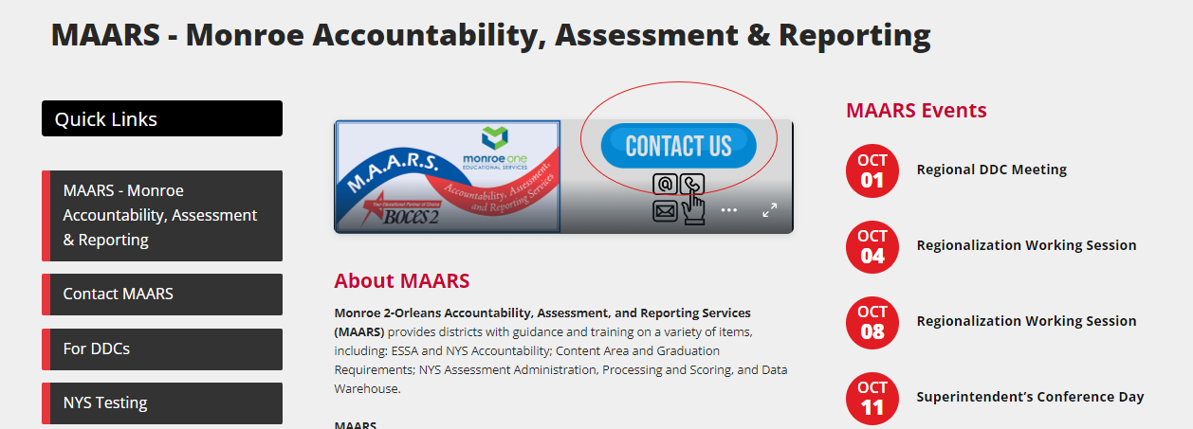
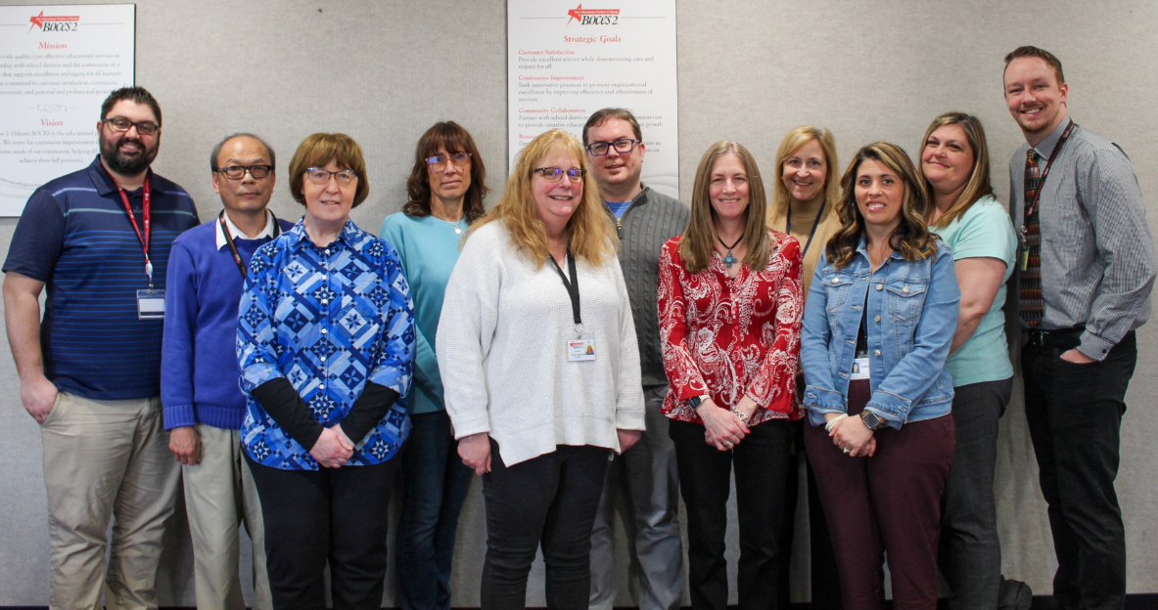
MAARS Team Introductions
Contact MAARS (monroe2boces.org)

Slide 4
Jill Slavny
Assistant Superintendent for Accountability, Technology, and Regional Services

Slide 5

MAARS Team Members - Shoutouts
Infinite Campus Team
  Lauren Amedeo
  Marcia Vick
School Tool Team
  Cherie Nothnagle
  Aurilla Putney
Programmer
  JR Lee
District Data Coordinator
  Lindsay Beaumont
Instructional Technology Specialist
  Dr. Deb Lubberts
Administrative Assistant
  Lucy Fagan

Slide 6
We want to know you!
Now that you know us...
Because we Maartians are fans of both alliteration and outer space, we are going to do an activty called:

Slide 7

MAARS' Mork & Mindy Mingling
In-person:
  Those with a Mork card must find someone with a Mindy card
Zoom:
  Breakout Rooms of 3-4 people.
All:
  Share 1 win that has made for "Happy Days"
  Share 1 thing that has been a challenge

Slide 8
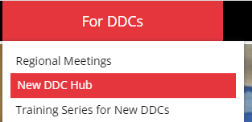
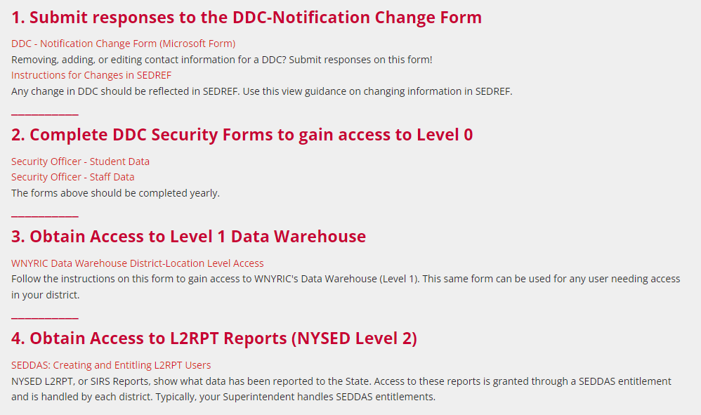
Website Update

Slide 9
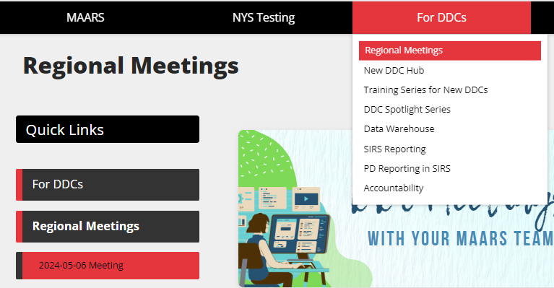
Meeting Handouts and Recording
Link
2024-10-01 Meeting

Slide 10
State Reporting
Notes:
Reminder: DO not change Student IDs

Slide 11
Reporting Data Monthly
(Districts, BOCES, Charters, and Non-Public Schools)
Reporting Data Monthly
  Demographic
  Enrollment
  Program Service
  Day Calendar
  Student Daily Attendance
  Course Instructor Assignment
  Student Class Entry/Exit
  Behavioral Inventions
  Staff Snapshot
  Staff Assignment
State encourages these templates be reported monthly
Rock Star Status!
Reporting Data Weekly
Import data into Level 0 weekly
Fix verification errors and do L1-Data Prep by Thursday at noon each week
MAARS recommends these templates be reported monthly, too

Slide 12
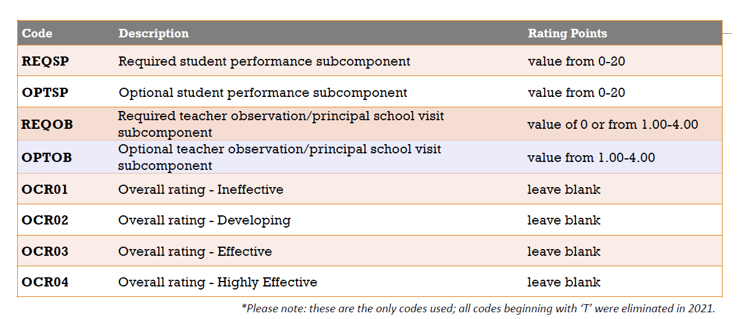
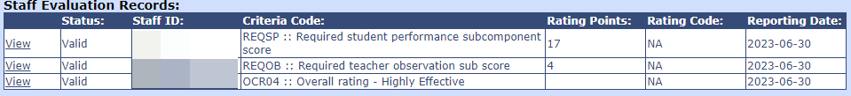
2023-2024 Staff Evaluation
(Districts & BOCES only)
Staff Evaluation Scores and Ratings data are due Thursday, October 17
Educator Evaluation Summaries were posted on the IRS Business Portal in SED Monitoring for each district/BOCES.

Slide 13
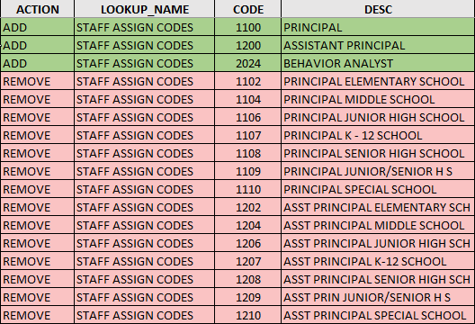
2024-2025 New Codes for Staff Reporting
(Districts, BOCES, and Charters)
Staff Assignment Codes
  Principal – 1100
  Assistant Principal – 1200
  Behavior Analyst – 2024
Tenure Area Codes
  COM – Computer Science

Slide 14
2024-2025 New Codes for Staff Reporting
(Districts, BOCES, and Charters)
Course Instructor Assignment Template - Instructor Type Code (Field #15)
  Report SUBSTITUTE or COLLEGE or leave blank
  Report substitute teachers if they are estimated to work more than 40 continuous days in the school with “SUBSTITUTE” in the Instructor Type Code field (#15). These individuals would be serving as teacher of record for a course/section until a permanent teacher returns or is hired.
  Report “COLLEGE” in field #15 in for teachers or administrators acting as instructor of record for a course offered in the school through an approved institution of higher education aka Dual Credit Courses
  Teachers reported with either of these codes will be excluded from the annual course-certification match process.
Staff Snapshot Template
  Substitute teachers must be reported in Staff Snapshot if they are reported in the Course Instructor Assignment template

Slide 15
2024-2025 Staff BEDS Day Reporting
(Districts, BOCES, and Charters)
Preliminary Staff Snapshot & Staff Assignment data due Thursday, November 14, 2024
Preliminary Course Instructor Assignment & Student Class Entry/Exit due Thursday, January 23, 2025
  Be sure to report Special Education and English as a New Language teachers in their own courses or by using the correct indicator/teacher role on the course section.
  Be sure to report librarians by assigning them to the course 99000- Library (Library Media Specialist) or 99899 – for elementary library managers who are not certified
Final Teacher Out of Certification data due Thursday, May 15, 2025
  The official NYS Out of Certification match is performed based on data through May 16, 2025. SIRS-328 Out of Certification report will be frozen as of this date.
Recommendation: Give appropriate HR staff SEDDAS entitlements to the Staff folder in L2RPT so they can review the SIRS-328 and SIRS-329

Slide 16

Questions?

Slide 17
2024-2025 Student SIRS Changes
Course Template
  New course codes
  Reminder: AP and IB courses should be mapped to the AP and IB course codes in the state course catalog even if students take corresponding Regents exams.
Student Lite Template
  New career path code: IAAP – Individual Arts Assessment Pathway
Assessment Name | Course Code | Last Administration | First Administration
Regents Common Core Geometry | 02072CC | January 2025
Regents Geometry | 02072 |  | June 2025
Regents Phy Set/Earth Sci | 03001 | June 2026
Regents Earth and Space Sciences | 03008 |  | June 2025
Regents Living Environment | 03051 | June 2026
Regents Life Science: Biology | 03050 |  | June2025

Slide 18
Behavior Interventions Data
New requirement for 24-25 and beyond
Districts, Charters, and BOCES must submit data through Level 0 on the use of physical restraint and timeout and substantiated and unsubstantiated allegations of corporal punishment, mechanical restraint and other aversive interventions, prone physical restraint, and seclusion.
Non-public schools will report data directly to NYSED utilizing a form in the IDEx on the NYSED Business Portal
Policy Related Guidance: https://www.nysed.gov/student-support-services/behavioral-supports-and-interventions-schools

Slide 19
Data Element | Instructions
Restraint Event Location Code | Report building where incident occurred. If the incident happened on grounds outside the building, report the location for the building where the student is enrolled.
Restraint Event ID | Use a unique ID for each event
Restraint Event Date | Date the event occurred
Restraint Type | Report restraint type code Codes: Aversive, Corporal, Mechanical, Prone, Seclusion, Physical, Timeout BIP, Timeout No BIP
Restraint Event Timespan Code | Codes: 01, 02, 03, 04
Substantiated Event | Report only if Restraint Type is Aversive, Corporal, Mechanical, Prone, or Seclusion; otherwise, leave blank. Codes: “Y"=Yes, "N"=No
Response Reason Code | Report code from the RESPONSE REASON table. Report only for authorized response types. Codes: Self, Students, Staff, Others, Non-authorized
Staff Training | Briefly describe the type of training the staff person involved in the event has had. Report only for authorized response types.
Incident Comment | Briefly describe the event.

Slide 20
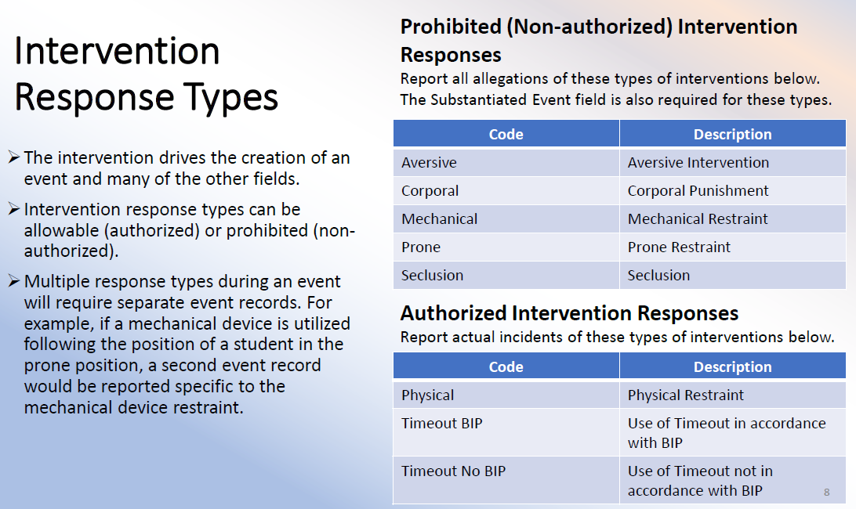

Slide 21
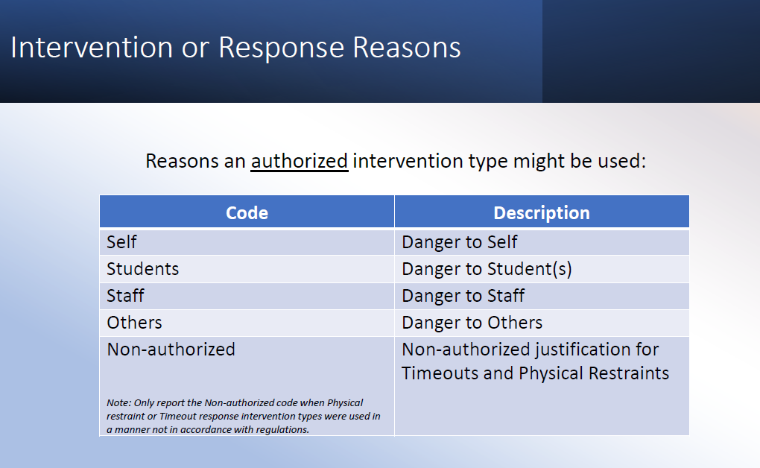

Slide 22
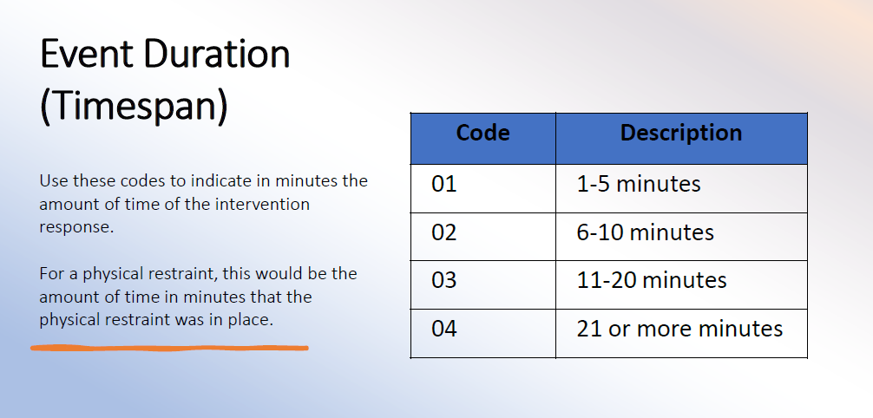

Slide 23
Questions?

Slide 24
August Graduates
(Districts, BOCES, Charters, and Non-Public Schools)
SIRS Templates: Student Lite, School Entry/Exit
Data:
  Student Lite: Credential Type and Career Path
  School Entry/Exit: Enrollment Exit Date and Enrollment Exit Code
Verification L2RPT: SIRS-308 Annual Graduation Report
Data due: Thursday, October 17

Slide 25
IMF BEDS Data
(Districts, BOCES, Charters, and Non-Public Schools)
This data is not collected through SIRS
IMF (Institutional Master File) form is available on the Data Exchange (IDEx) via Application Business Portal
Religious and independent school immigrant student counts should be included on your BEDS District Summary form. This data is collected for Title III funding allocations.
Due Friday, November 15
Resources: https://www.p12.nysed.gov/irs/beds/IMF/home.html

Slide 26
Student BEDS Data
(Districts, BOCES, & Charter Schools)
BEDS Day Enrollment Extract (SIRS 312, 313, 314, 316, 319, 350)
  Enrollment by grade, district of residence, district Pre-K, and supplemental enrollment counts are collected for calculating preliminary State Aid allocations
BEDS Day Free and Reduced Priced Lunch Extract (SIRS-323 and SIRS-327)
Due Thursday, January 2

Slide 27
Student Digital Resources Survey
(Districts, BOCES, & Charter Schools)
SIRS Template: Student Digital Resources Survey
Annual Collection – Districts, BOCES and Charter Schools are to survey parents/guardians each school year
Verification L2RPT: SIRS-336 Annual Digital Resources Survey Report
Data Due: Thursday, January 23

Slide 28
Preliminary CIA/SCEE
(Districts, BOCES, & Charter Schools)
SIRS Template:
  Course Instructor Assignment
  Student Class Entry/Exit
  Course
  Location Marking Period
  Staff Snapshot
Used by the Office of State Assessment for determining counts for students enrolled in courses leading to a State assessment
Verification L2RPT: SIRS-330 Student Class/Course Instructor Summary Report
Data Due: Thursday, January 23

Slide 29
Program Service Data
SIRS Templates: Program Fact
Eligible for Alternate Assessment (0220)
  Verification L2RPT: SIRS-401 Reasonableness Report
  For enrollment load to KITE Educator Portal for NYSAA
  Data due Thursday, November 5
SIRS BEDS Day Extracts
  Free & Reduced Lunch and Poverty (5817, 5806, 0198)
    Only students who meet the eligibility requirements
    Verification L2RPT: SIRS-323 and SIRS-327
  Data due Thursday, January 2
Summer School Program Services
  Verification L2RPT: SIRS-401 Reasonableness Report
  Data due Thursday, August 15

Slide 30
Program Service Data
SIRS Templates: Program Fact
PreKindergarten
  UPK – 902 and UPK Setting Code
  Other Pre-Kindergarten – 990
  Office of Early Learning will use the higher of two data points to determine counts for UPK funding
    BEDS Day (Oct. 2, 24)
    March 12, 2025
  Verification L2RPT: SIRS-316 for BEDS Day and SIRS-333 for March 12
  Data due Thursday, June 5

Slide 31
Local Student ID
The Local Student ID is like a Social Security Number
  Unique to each student
  Identifies who that student is
A student’s local student ID is linked with their NYSSIS ID in the NYSSIS System
Once a local student ID is assigned to a student, it should NOT be changed
Problems from changing local student IDs
  The student may be duplicated in the NYSSIS System
  Testing data may not link with student properly
  Student may be represented twice on Accountability Reports
Date ID Assigned | Student | Local ID | NYSSIS ID | ELA Test | Math Test | Science Test
9/1/24 | John Doe | 12345 | 123456789 | X | X | X
3/2/25 | John Doe | 54321 | 987654321

Slide 32
Questions?

Slide 33
Level 0: version 20.0
New features:
New NYSSIS ID field in student’s Demographic record
New Data Quality report to show students with no SCEE records
New dual credit field in Student Class Entry Exit Course Roster By Teacher Report
New Behavioral Intervention Template
Updates / Bug Fixes:
Course Report: Course/Tchr/Student Unique Student Count column
Student Lite: required contact information delayed with 20.0a
Fatal Errors:
Staff Assignment SA7616 & SA7618
Matt Fredericks
mfrederi@bocesmaars.org

Slide 34
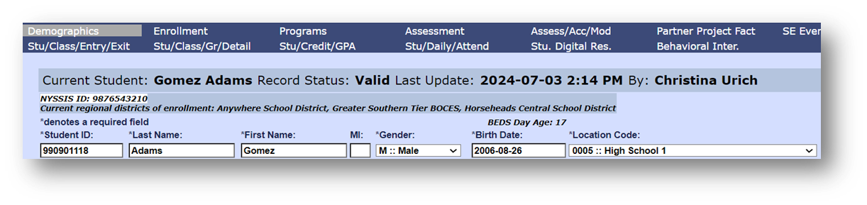
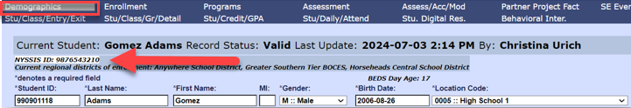
Level 0 New: New NYSSIS ID field
Reports > Demographics > Dist. School Summary > Select Location > Select Student
or
Manual Input > Demographics > *Perform Student Search
Will eventually populate for each student
Dependent on data populating in L1’s Student_Ident table
Displays ‘N/A’ when not available

Slide 35
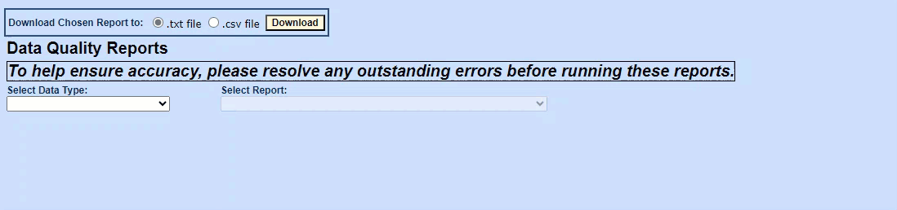
Level 0 New: New DQ report – Students with no Student Class Entry Exit records
Reports > Data Quality Reports > Select Data Type : Enrollment > Select Report: No Student Class Entry Exit (SCEE) Records Summary
Includes enrollment entry codes 0011 (building or grade) and 055 (instructional reporting only)
Includes only “In-District students” (i.e. no OODP “Out of District Placed”, BOCES, etc…)
Has an optional filter by location drop-down.
Columns with Enrollment Entry Date / Entry Code and Exit Date / Exit Code.

Slide 36
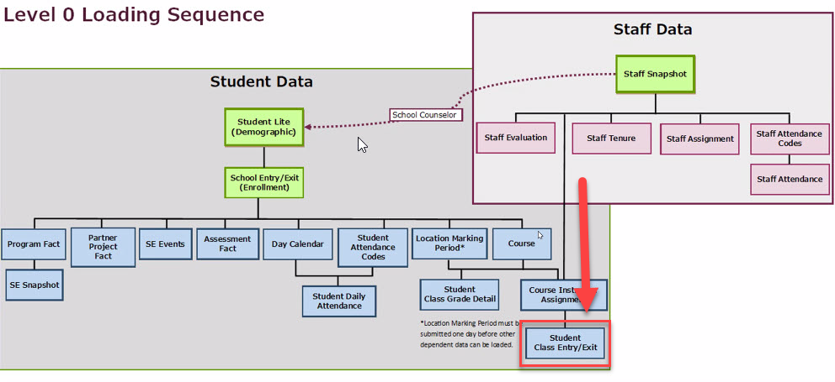
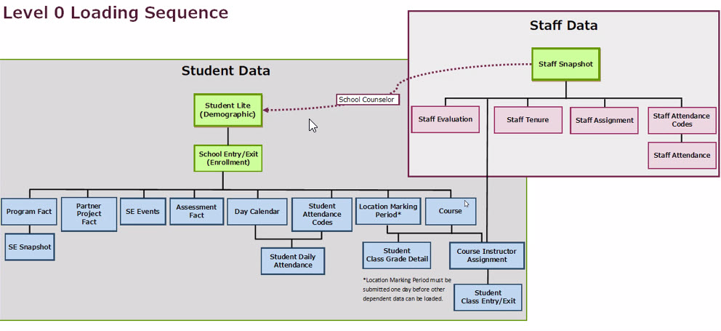
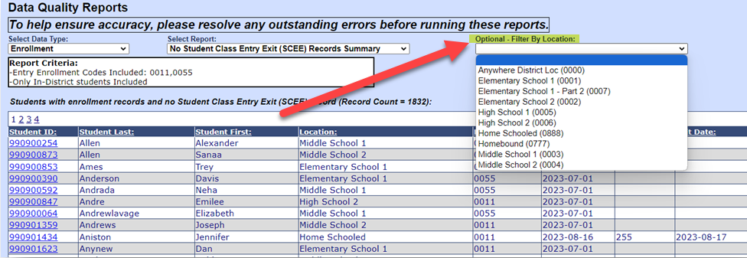
Level 0 New: New DQ report – Students with no Student Class Entry Exit records
Reports > Data Quality Reports > Select Data Type : Enrollment > Select Report: No Student Class Entry Exit (SCEE) Records Summary
Includes enrollment entry codes 0011 (building or grade) and 055 (instructional reporting only)
Includes only “In-District students” (i.e. no OODP “Out of District Placed”, BOCES, etc…)
Has an optional filter by location drop-down.
Columns with Enrollment Entry Date / Entry Code and Exit Date / Exit Code.

Slide 37
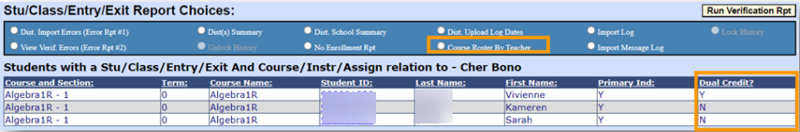
Level 0 New: Student Class Entry Exit
Reports > Student Class Entry Exit > click “Course Roster By Teacher” radio button > click “Run Verification Rpt” button
A ‘Y’ under Dual Credit will indicate the course is Dual Credit.

Slide 38
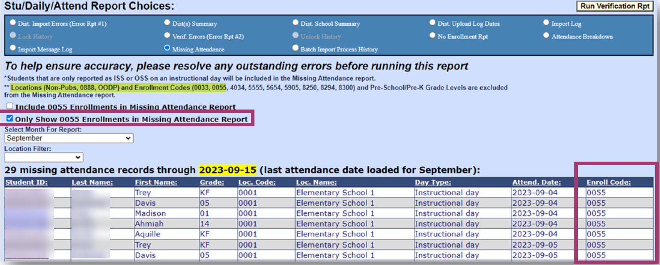
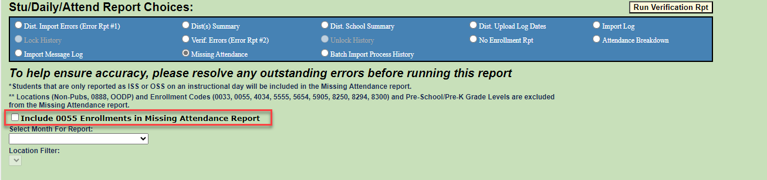
Level 0 New: Missing Attendance Report
Reports > Stud/Daily/Attend > click Missing Attendance radio button
Added Checkbox to “Only show 0055 enrollments”
Added enrollment code to the report

Slide 39
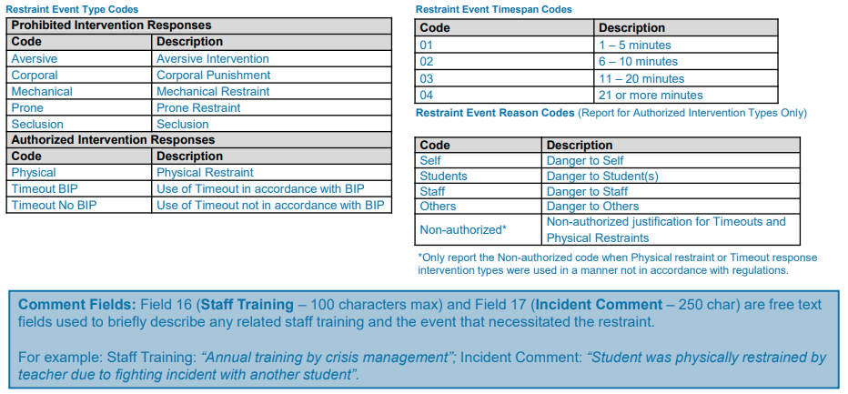
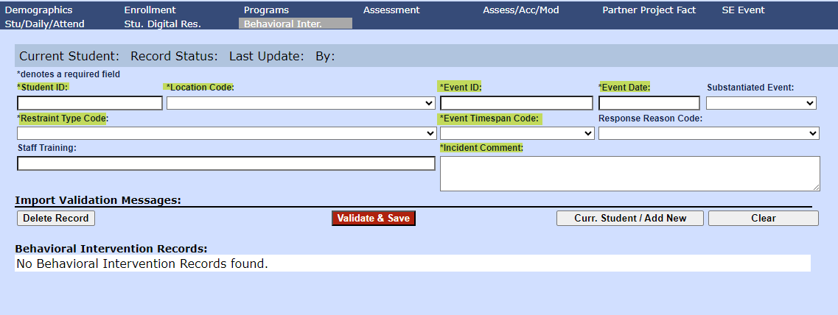
Level 0 New: Behavioral Intervention
A breakdown on required fields can be found: https://www.nysed.gov/memo/information-reporting-services/reporting-student-behavioral-interventions-2024-25-revised

Slide 40
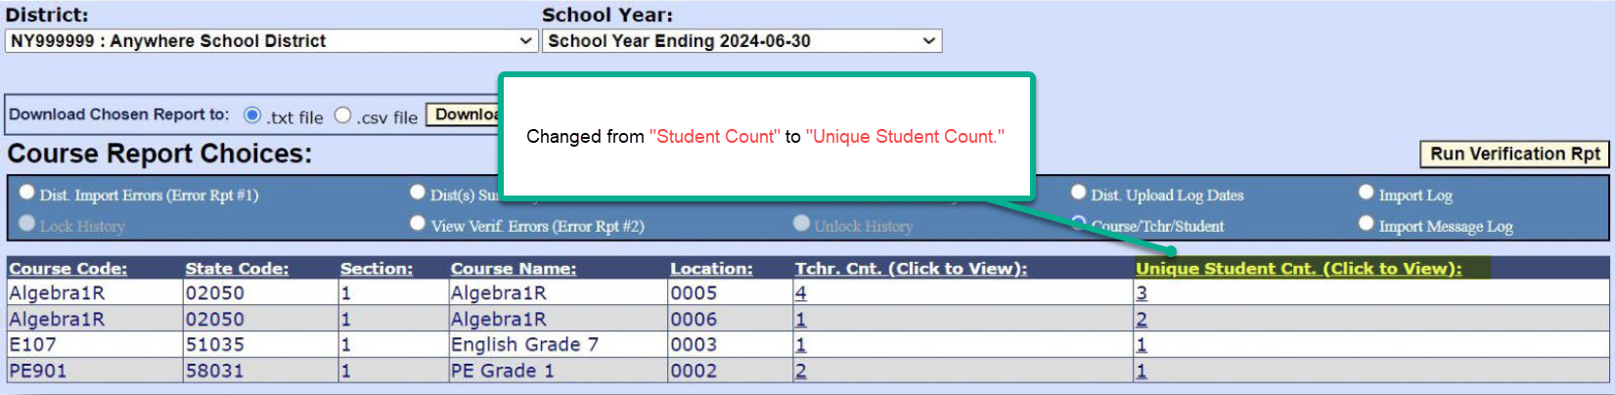
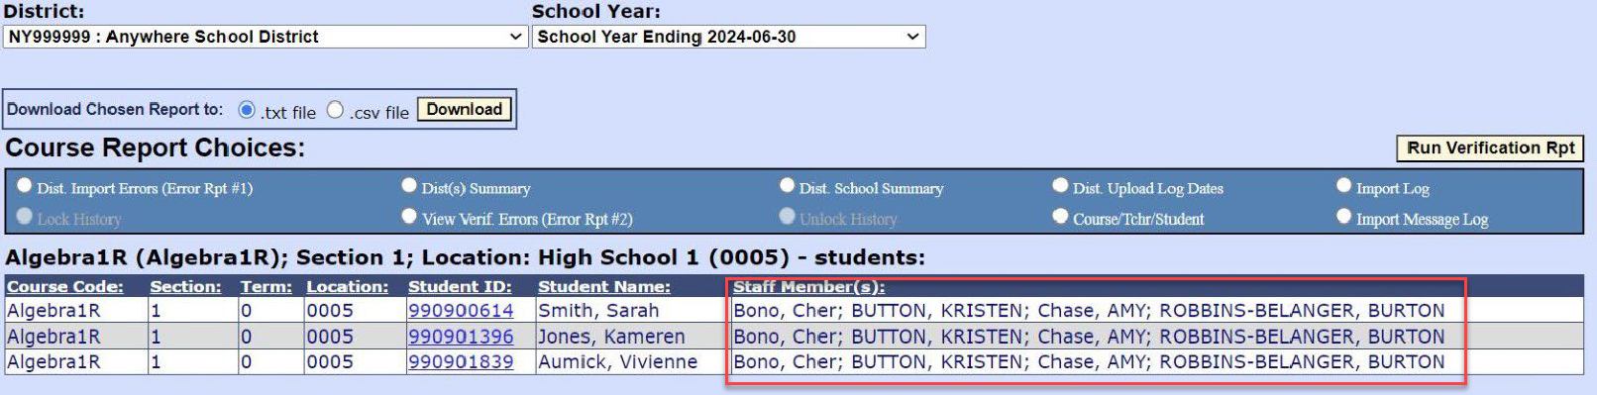
Level 0 Updates: Course Report – Course /Tchr/Student
Reports > Course > Select Course/Tchr/Student radio button
Made the count of students unduplicated
Switched the column name from “Student Count” to “Unique Student Count”
Drilling down to the value under “Unique Student Count” will show a list of teachers ( one row for each unique student )

Slide 41
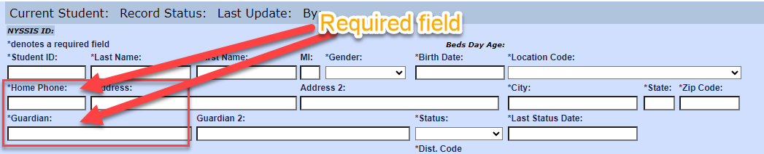
Level 0 Updates: Student Lite- required contact information
DM1109 v20.0 Missing or Invalid Home Phone number (must be at least 10 characters)
DM1110 v20.0 Missing Primary Guardian
Updated 20.0a changed DM1109 & DM1110 back to Information errors ( a.k.a warnings ) until January 2025.

Slide 42
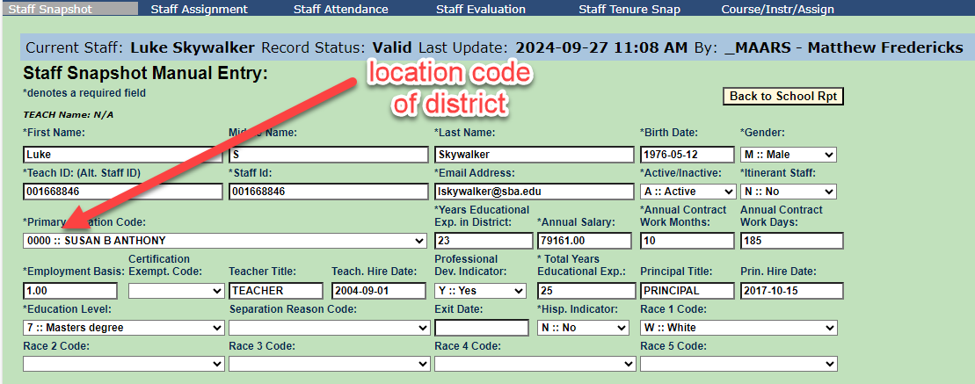
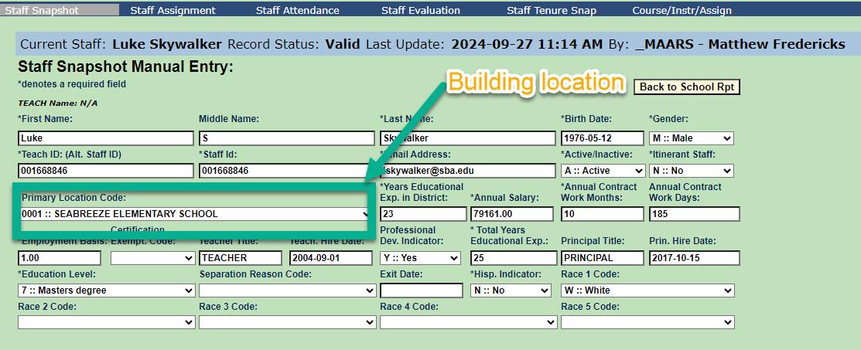
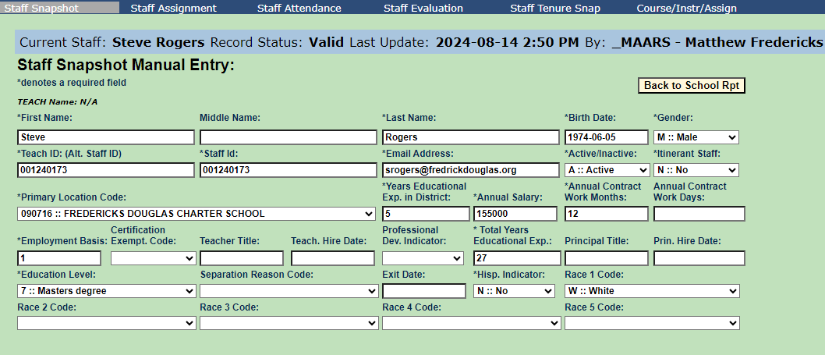
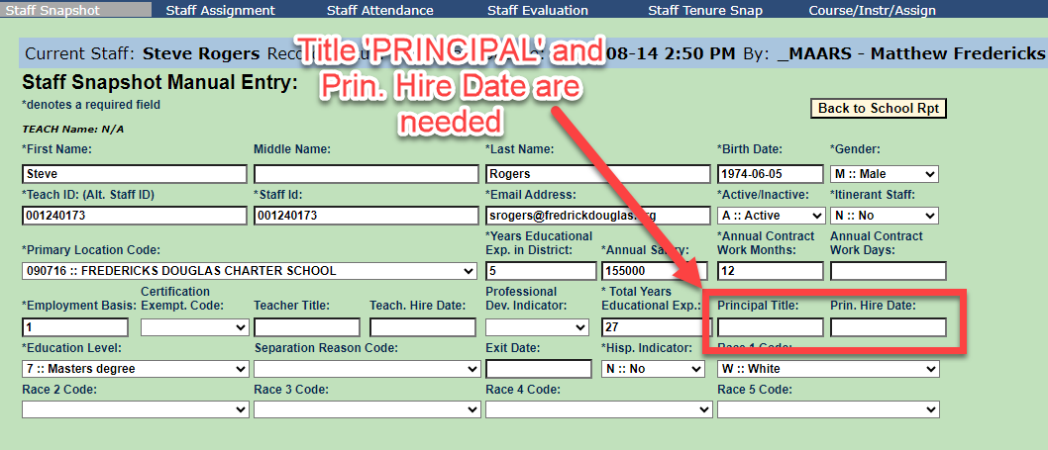
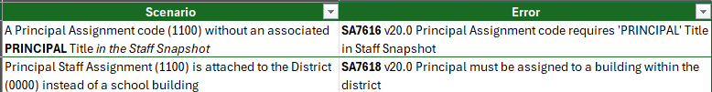
Level 0 new Warning Fatal (W/F) Errors: Staff Assignment
Warning/Fatal (W/F) Error: Errors that are identified when the verification process is run. Information from one template is dependent upon information from another.
Remember: “Run All Verification Checks” when making changes directly in Level 0 and don’t forget to make subsequent changes in your source system if your using electronic import.

Slide 43
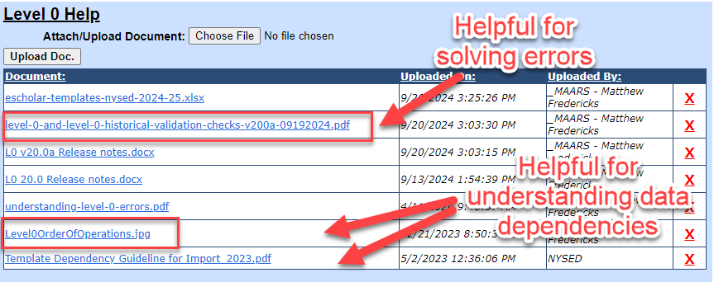
Level 0: Reminders
Security Forms for Student and Staff data are due Friday October 4th.
Private Schools and Charters: Email your rollover requests to mfrederi@bocesmaars.org for Demographic, Enrollment, and Program Fact. Staff snapshot rollovers request can made at this time.
Please check the Help section for helpful documentation for this release and future level 0 changes.

Slide 44


Slide 45
Pupils with Disabilities Reporting
Notes:
Pupils with Disabilities Reporting

Slide 46
PD BEDS Reporting
SPED Data to Upload through SIRS for BEDS Day Reporting
      Type of Disability
      Preschool and School Age disability codes
      BEDS / October Snapshot
      Includes students with an IEP in effect on BEDS day, and with programs or related services that span BEDS day 10/2/24
Notes:
Coordinate the upload of the special education data which is contained in the Type of Disability and BEDS/October Snapshot.

Slide 47
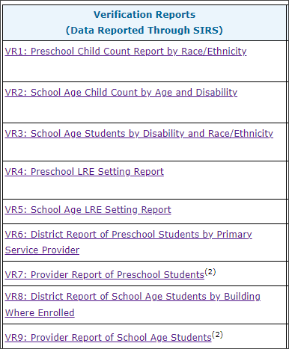
PD BEDS Reporting
Special Education Snapshot Data for BEDS day
Populates VR’s 1-6, and VR 8 in the PD Data System
Preschool Reports: VR1, VR4, VR6, VR8
School Age Reports: VR2, VR3, VR5
VR7 and VR9 informational reports – review for accuracy
Required submissions and instructions for each report can be found on the SEDCAR site:
Coming Soon!
Notes:
The October Snapshot reports preschool and school age SWD data and is certified in the PD Data System by your PPS/SPED Director or Superintendent

Slide 48
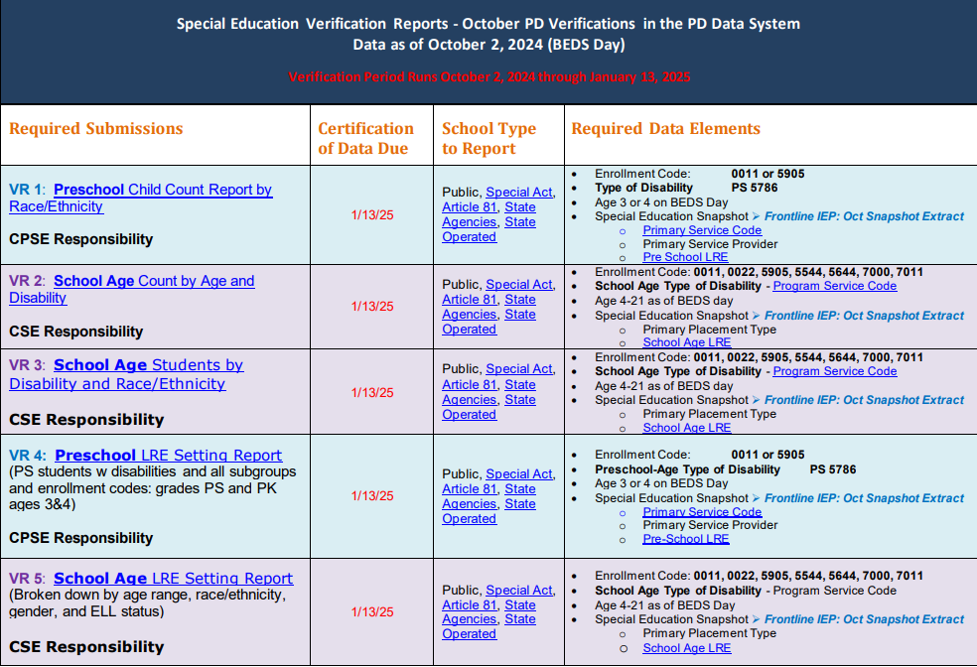
October Snapshot Reporting Table
Certification in the PD Data System is due by January 13, 2025 – LAST Level 0 upload date: 1/9/25
Make your due date at least 2 weeks prior
Can start uploading October Snapshot data to Level 0, but PD Data System is not yet populating reports
Notes:
HANDOUT:
This reporting table handout lists the data points used to fulfill each VR, and which entities need to report and/or review

Slide 49
PD Reporting: Enrollment Reminders
  Preschool Students - 4034 Determining Eligibility enrollments need to be reported throughout the year as they happen
  Start Date: Date of Referral to CPSE
  End Date: Date determination made, or the process ended
    The date eligibility was determined is the end date of the 4034 enrollment and is contained in the student's Process Tracking log entry
  End Code: ALWAYS 140
  Start 0011 the next day for students found Eligible (See TRR for PS Age and PK Students, Scenario #2)
    Use location code of provider
    If unable to procure provider or on a waitlist, use 0777 home bound location

Slide 50
PD Reporting: Enrollment Reminders
  Preschool Students - 4034 Determining Eligibility enrollments for students not determined by 6/30/24
  END with 140 on 6/30/24
  START new 4034 7/1/24
  END DATE of rollover 4034: date eligibility determination was made, or the process ended
  Start 0011 the next day for students found Eligible (See TRR for PS Age and PK Students, Scenario #2)
    Use location code of provider
    If unable to procure provider or on a waitlist, use 0777 home bound location

Slide 51
PD Reporting: Enrollment Reminders
  To Avoid Level 0 Errors on Your TOD Import:
  All preschool-age students with disabilities (CPSE) who transition to Kindergarten in September require a 'summer enrollment', even if they did not receive ESY services, including those declassified as CPSE at the end of the summer.
    Needed to report the 5786 PS Type of Disability Code captured in the Year-End Snapshot reporting for VR13
Grade Level: Report Student with a PS grade level UNLESS they were enrolled in PREK in the previous year, then continue the PREK grade level
0011 Enrollment for Students who did not receive ESY:
  Use 0777 location code, OR the previous year's location code
011 Enrollment: Students who received ESY:
  Report enrollment with the location of the service provider
NOTE: CPSE students declassified before July 1 do NOT require a 'summer enrollment’ and can be started at the Kindergarten grade level starting 7/1

Slide 52
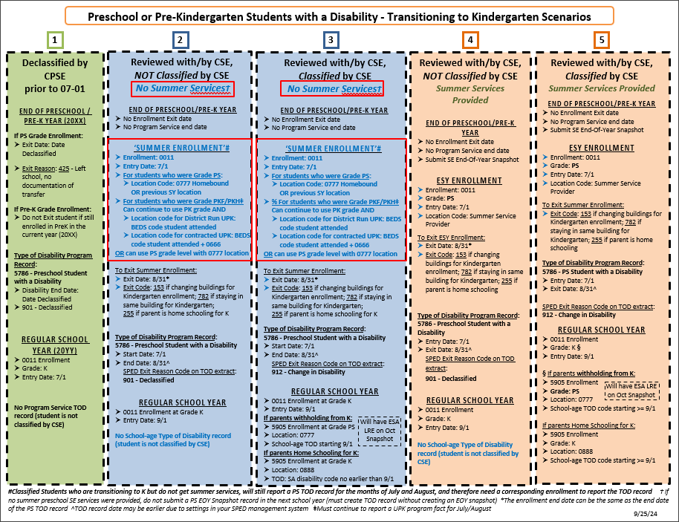
Preschool or PreK SWD Transitioning to Kindergarten - Reporting Scenarios
Updated version can be found on the MAARS PD Reporting web page
Notes:
Sample of CPSE to K Transition table available as a handout

Slide 53
PD Reporting:
MAARS Contacts for Data Reporting
PD Reporting through SIRS: SPEDHelp@bocesmaars.org
Kerri Baxendell 349-9077 SPEDHelp@bocesmaars.org
  Jim Saintours 349-9052 SPEDHelp@bocesmaars.org
  Level 0:
  Matt Fredericks 349-9064 mfrederi@bocesmaars.org
  SIRS Data:
  Laurie Hazard 349-9051 lhazard@bocesmaars.org
  SMS Specifics: Contact your SMS Liaison
Notes:
Watch the MAARS Weekly for any PD reporting updates or supplemental help sheets

Slide 54
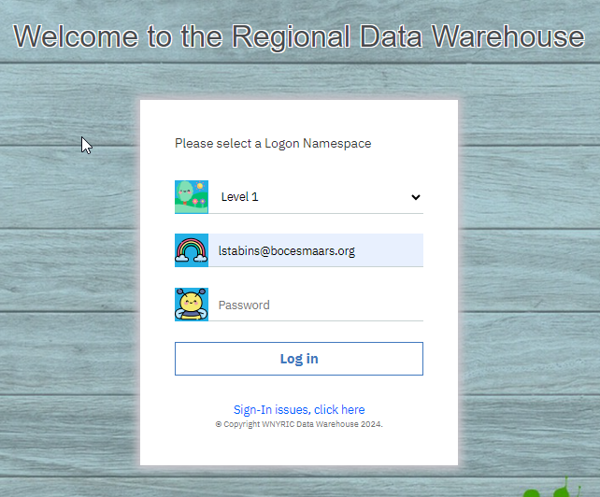
Level 1
Please log in to Level 1 https://dataview.wnyric.org/

Slide 55
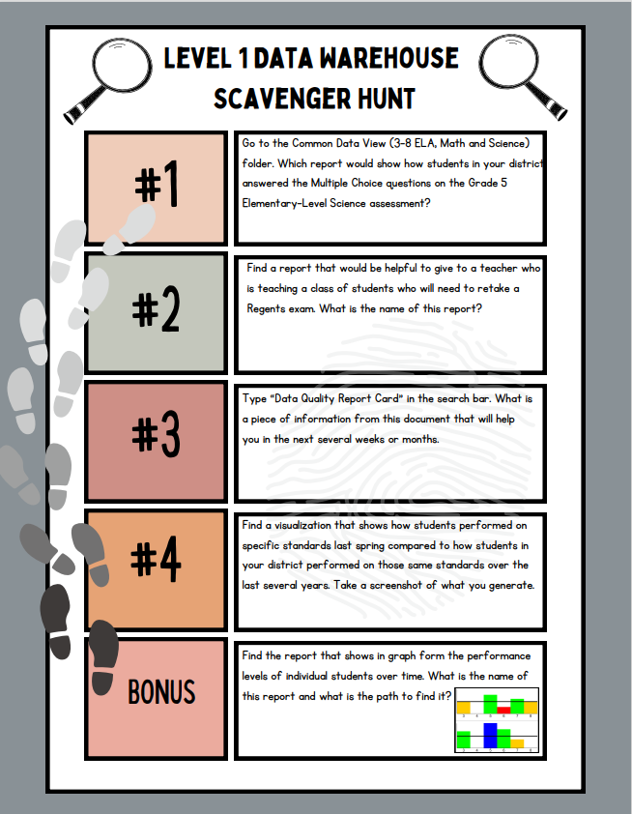
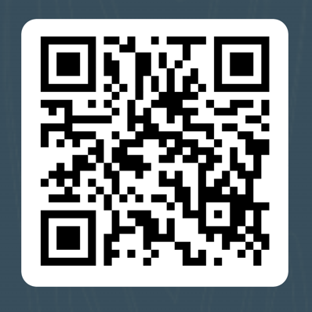
Use the paper, link or
QR code to complete
the Scavenger Hunt
https://forms.office.com/r/fNcxyd5nFt

Slide 56
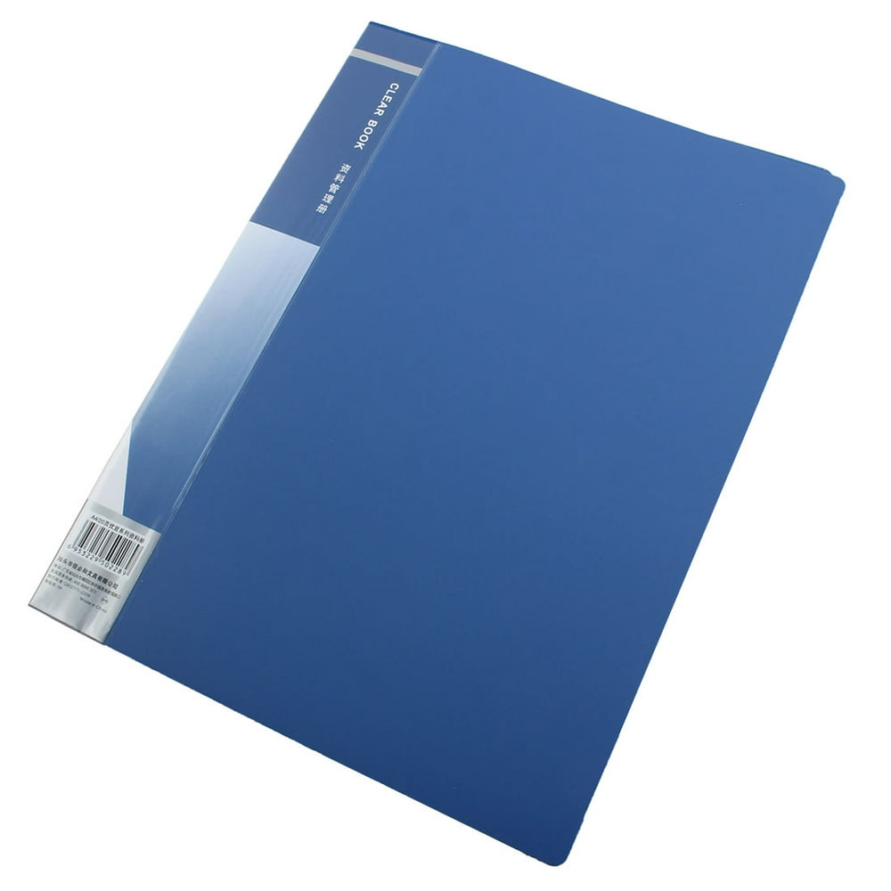

Lorena is happy to provide:
Introduction to the Reports that Guide Curriculum & Instruction
Support District Data Coordinators
Support District and School Administrators
Support teachers or teacher teams in data analysis of state or other locally collected data
Lstabins@bocesmaars.org

Slide 57
SED Testing Updates

Slide 58

SEDREF – Keep Up-to-date
Please keep SEDREF updated.
  Test Coordinators (3-8 & NYSAA), Principals, Superintendent, ASI… etc.
  These data are used by NYSED for …
    Sending information to all schools such as NYS Exam ordering memos and other important information.
    CBT (computer-based testing) user access to Nextera Admin (ELA, Math and Science)
    CBT (computer-based testing) user access to Kite Educator Portal (NYSAA)

Slide 59
Best Practice reminders from NYSED
*** Updating SEDREF ***
Best Practice reminders: SEDREF
It is important to remind CEOs and the DDCs to conduct an annual audit of the public query for SEDREF. If information is incorrect or needs updates, they follow the guidance on the NYSED website:
Changing Information in SEDREF
If you are a representative from a School District, Public School, Nonpublic School, Charter School, BOCES, or RIC and you need to contact SED for a change in your contact information (including Director of Special Ed), or for a BOCES virtual location, please proceed as follows:
For Nonpublic School CFO information, the change must be captured on this CFO form (38.5 KB) or this CFO form in PDF and emailed.
For other contact info changes, including CEO, for the above types of Institutions, a change request must be made via a formal communication on the Institution's letterhead and must include the following:
  School BEDS code
  email address and phone number of the new individual
  effective date of the change
  signature of current superintendent or principal

Slide 60
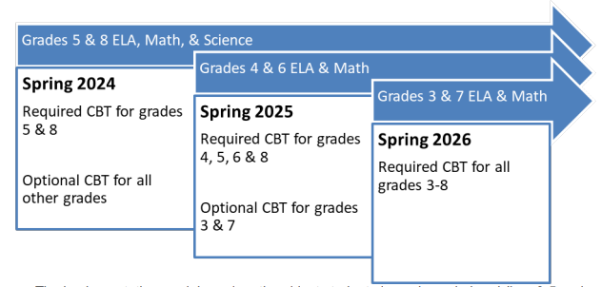


CBT Required grade levels for 2024-2025
  Operational CBT required participation grades for this year:
  [ ELA & Math (4, 5, 6, & 8), Science (5 & 8)participation. ]

Slide 61
CBT Support Articles Updated
The following Six CBT Support Articles Have Been Updated By NYSED for 2024-2025
Please Review Each of These...
Concurrent Logins – Computer Based Testing (nysed.gov)
Speech-to-Text Accommodation for English Language Arts
How to Update Teacher Accounts in Nextera Admin
Text-to-Speech (TTS)
Monthly Events Calendar for CBT
Fall Roadshow Training: NYS Grades 3-8 English Language Arts (ELA), Mathematics, and Grade 8 Intermediate-Level and the Grade 5 Elementary-Level Science Tests

Slide 62

3-8 Assessments – ELA, Math & Science Ordering Memo
NYSED Assessment Ordering Memo:
Requesting memo & related instructions will go out when the system is ready to open.
NYSED Target date – October 1st
The memo will be sent out to all Principals and school leaders.
  Please note that the online ordering system, once open, will close November 8th.
  Schools will have about 6 weeks to complete their orders.
  Please do not wait until the last minute to complete your order.
Please make sure to carefully review this memo,
as it will include important information concerning...
  The opening of the online request system
  Lead Scoring Entity (required in each year's orders)
  Statewide CBT Simulation as well as Stand-alone Field Tests.
  Tech Readiness... etc.

Slide 63

CBT dates to keep in mind
Starting October 1, 2024 (Today)
The Nextera Admin Flip will be completed, Nextera Admin opened, and
“Welcome to Nextera” emails will go out to users
RIC level users are expected to go out first.
The Technology Readiness Checklist will also be available October 1st.
Secure browsers available.
These are the secure browser anticipated to be used for 2025 simulation, operational, and field testing.
CBT Online request system should open early October and will close November 8th.
Schools will have about 6 weeks to complete their requests
CBT Simulation: anticipated to take place January 21 – January 31, 2024
  The structure will be the same as in previous years –
  schools will have the window to run their simulation, can choose what day(s)..etc.
ThePhoto by PhotoAuthor is licensed under CCYYSA.

Slide 64
Tech Readiness 2024-2025
Very important note from NYSED...
This year, NYSED will not be tracking Tech Readiness completions.
Which means, the RICs (us) will no longer be receiving the usual information lists to confirm that each of your schools have completed this task.
Per NYSED, the schools will take the responsibility for completing their Tech Readiness check lists.
Reminder: Tech Readiness is required by all CBT schools every year.
It is important that each school make sure they are "Tech ready"! Every year!
Doing this, each and every year, greatly helps to ensure a smooth testing window.
Not doing so, could put the school in a situation of having a technology issue during testing. (no school should want to take that risk)

Slide 65

Accessing Questar Secure Browser
Practice Tests AND Question Sampler
It is a good idea that any new student to your school, that has not already been exposed to NYSED CBT testing for grades 3-8, should be given the chance to practice using either the Secure Browser Practice Tests OR Question Sampler.
SECURE BROWSER PRACTICE TESTS:
The link below will take you to the ELA, Math and Science practice tests
Questar Secure Browser Practice Test Logins
QUESTION SAMPLER:
New York Question Sampler

Slide 66

CBT Simulation
Same as last year... All schools that will be participating in Operational CBT are also required to participate in the CBT Simulation. (Remember, Science is a part of the Simulation)
(Level 0 student data updated by end of day Thursday 12/5/24):
for Statewide Pre-ID data pull)
(including enrollment, program services , and demographic data)
CBT Simulation: anticipated to take place January 21 – January 31, 2024
  The structure will be the same as in previous years –
  schools will have the window to run their simulation, can choose what day(s)..etc.

Slide 67
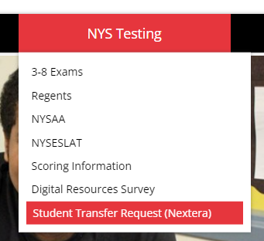
CBT: Nextera Student Move Requests
We will collect Nextera student move requests the same as we have in the past.
The Microsoft form link will be sent out all schools once Nextera opens for test setup and through-out testing window for both Simulation and Operational CBT testing.
All schools requesting a student move will be asked to indicate ELA, Math and/or Science in their requests

Slide 68

Paper Answer Sheets (ELA, Math, Science)
CBT MANDATED GRADE LEVELS 4, 5, 6 & 8, including any schools with CBT grades 3 or 7:
We will send out an order form for collecting paper answer sheet requests on students that have IEP/504's attending schools' that are CBT full grade levels.
Please remember that we cannot give a CBT student a paper answer sheet if they do not have that IEP/504 as "taking paper"!
PBT GRADE LEVELS (grades 3 & 7 ONLY)(ELA & Math Only):
We will be collecting information from all schools to get a list of what grade levels will be CBT and what grade levels will be PBT again, for this year's testing.
  Schools with full grade levels that will be PBT this year(grade 3 & 7, that are NOT doing CBT) will get their bulk answer sheets printed automatically for ELA and Math only.

Slide 69
Paper Answer Sheets vs CBT
Please …. Please … Please …. DO NOT ...
allow a student to take part of a test CBT and part PBT.
  This situation will cause the student's exam to be processed during year-end clean-up.
  Which will delay the student's final score's being available, as the 2 parts need to be manually scored and murged together for reporting to NYSED during year-end clean-up.
  If you have a new student enrolled in your school from a NYS school, reach out to the previous school to get the student's 3-8 testing status. If they have completed part of a test, find out what platform the student took the test in (CBT or PBT). That platform should be the platform the student will need to use to complete that exam.
  NYSED will speak more about this issue during the NYSED Road Show Training.

Slide 70
Math & Science Alt. Languages PBT & CBT
*** Alternate Languages ***
There will be NO alternate languages available for CBT (Computer Based Tests)
Alternate languages will be available as paper-based tests (PBT) only.
All alternate language tests will be paper editions. ELL students can test on the computer in English and use an alternate language paper copy for reference or they can test solely on paper with an alternate paper copy and an English paper copy. ELLs requiring an oral translation must test on paper.
The alternate languages for this year's Math and Science are … Arabic, Bengali, Chinese(Simplified), Chinese(Traditional), Haitian-Creole, Korean, Russian, and Spanish.

Slide 71
Nextera Admin – Local ID Number
*** SAME AS LAST YEAR ***
Local ID numbers are not required in Nextera Admin (same as last year)
However, the Local ID box/field will still be available in Nextera for those folks that want to use them.

Slide 72
Scoring Materials ELA, Math and Science (CBT & PBT)
Scoring materials for ELA, Math and Science will need to be accessed via Nextera Admin's "Help" tab drop-down menu.
Scoring keys wil be posted once the testing window opens
All schools (superintendents, principals and test coordinators) should receive their "Welcome to Nextera" (Nextera Login) emails by end of day today (October 1, 2024).
If you any have questions, please do contact me.

Slide 73
NYSED Regional CBT Training 2024-25
NYSED & NWEA will be coming to our area October 23rd at BOCES1 (Fairport) for the 2024-25 CBT Training.
Training session will be from 8:30am – 12:30pm
Register Here

Slide 74

3-8 Testing - Questions

Slide 75
Regents, NYSITELL, and Digital Resources Survey
Patty Zeiner, pzeiner@bocesmaars.org

Slide 76
Regents
August Regents – Demographic (Student Lite) and Enrollment (School Entry/Exit) must be in Level 1 before we can report your August Regents scores
2025 Regents Exam Dates
  January 2025 Regents Examination Schedule (nysed.gov)
  June 2025 Regents Examination Schedule (nysed.gov)
  August 2025 Regents Examination Schedule (nysed.gov)
  New Regents Exams that will require early administration, score collection, and standard setting: 2024–2025
  Life Science: Biology – Course Code 03050
  Earth and Space Sciences - Course Code 03008
  Geometry - Course Code 02072
Notes:
The Dos and Don'ts

Slide 77
NYSITELL
M.A.A.R.S. High Level Process
  Forms have not changed since May 2018
M.A.A.R.S. will load NYSITELL results to Level 1, on the last Wednesday of each month starting in October, for all schools.
Verification reports:
  L1: Accountability: Assessment Scores, Levels, Trends & Grad>NYSITELL&NYSESLAT>NYSITELL Student Scores
  L2: L2RPT Reports-SEDDAS>Tested/Not Tested>SIRS-104 NYSITELL Summary Report
NYSED is not providing the conversion charts for NYSITELL exams.

Slide 78
Digital Resource Survey
MAARS Student Digital Resources Survey Service
MAARS offers pre-printed survey sheets and processing for the Student Digital Resources Survey
If your school plans on using MAARS for preprinting/scanning please reach out to Patty Zeiner.
High Level Process
Digital Surveys are printed using student data in Level 0
Demographic (student lite) and enrollment (school entry/exit) data must be in Level 0 before we can preprint surveys
PROCESS
The process is modeled after our Regents process using Teleform software. The survey is available in English and Spanish.
There are two sort options for pre-print survey sheets
BLDG, GRADE, LAST NAME
GRADE, LAST NAME
MAARS will pre-print survey sheets with 20 blanks for each school. If needed, schools can request additional blanks. Please contact Patty Zeiner 349-9053 or pzeiner@bocesmaars.org
MAARS will notify schools when pre-printed sheets are ready for pickup.
PROCESSING
Districts will use Teleform to scan and verify survey sheets
Charters will deliver completed surveys to MAARS for processing.
A CSV file will be generated with the survey responses.
MAARS will post the file for Charter Schools on the FTP under 2023-2024/Digital Equity Survey
Districts and Charters are responsible for importing this data to Level 0 for State Reporting by Thursday, January 23

Slide 79

MAARS Professional Development Opportunities

Slide 80
MAARS Professional Development Opportunities
Look for announcements, dates, and sign ups in our MAARS Weekly Digest
New District Data Coordinator Trainings
  Level 0 – Video Available Now
  State Reporting Basics
MAARS Spotlight Series
  Short (approx. 1 hr), focused trainings that providing a deep dive into one or two topics
eDoctrina Imports and Reports – 1:1 with Ryan
Lorena's PD will be listed on MAARS homepage!
  Data Warehouse, Assessment Best Practice

Slide 81
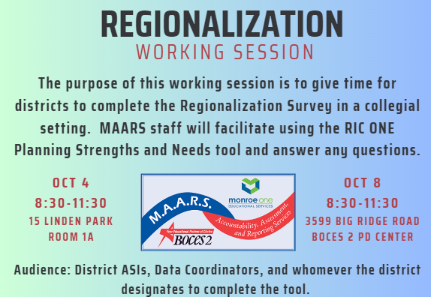
See some of you soon!

Slide 82

Next Meetings: All on Zoom
December 3rd
10-11:30
March 4th
10-11:30
May 6th
10-11:30
One Registration Link for all meetings.
Ryan will push out an email an hour beforehand to resend your unique zoom link to your email.

